Slide 1
Heat Map Segmentation Tutorial
By: Asad Mirza
For: CV-PEUTICS

Slide 2
Prerequisites
Worked with stained images and must be in color (MxNx3)
Information on how many proteins/regions are in your image.
What their respective labels/names are

Slide 3
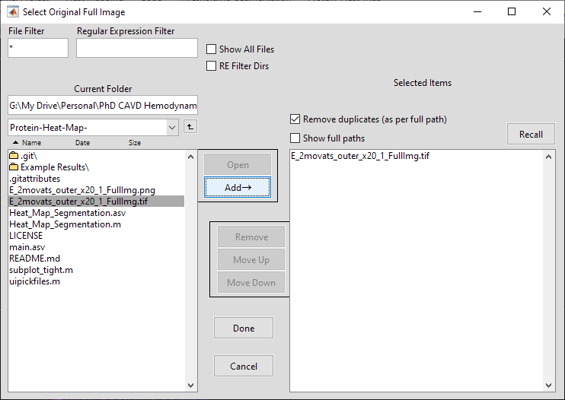
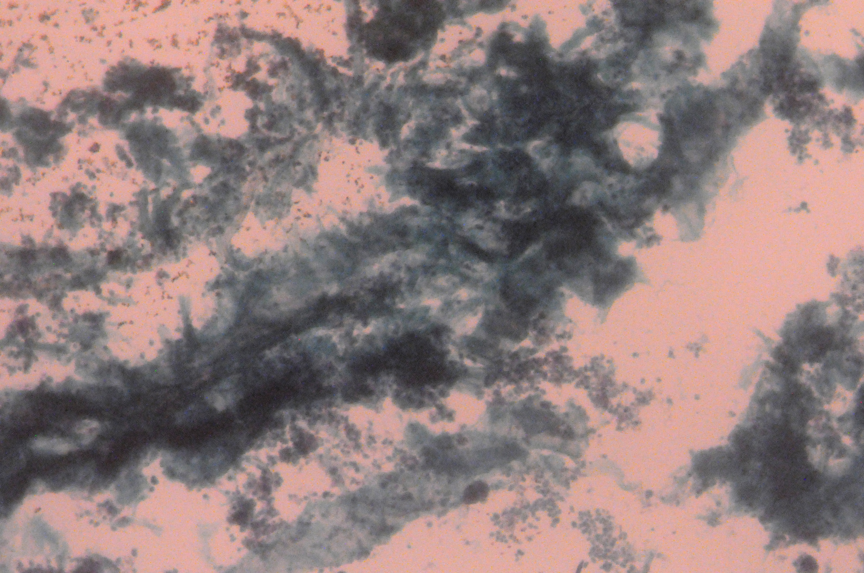
Load Image
High quality TIFF images preferred.

Slide 4
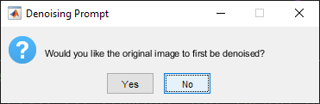
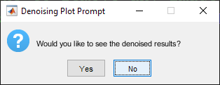
Remove Image Noise
Optional noise removal included. Median and Wiener filter included, image with least noise output chosen automatically.

Slide 5
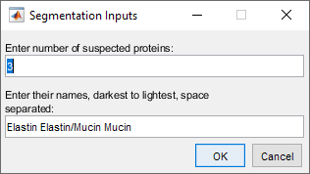
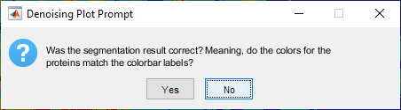
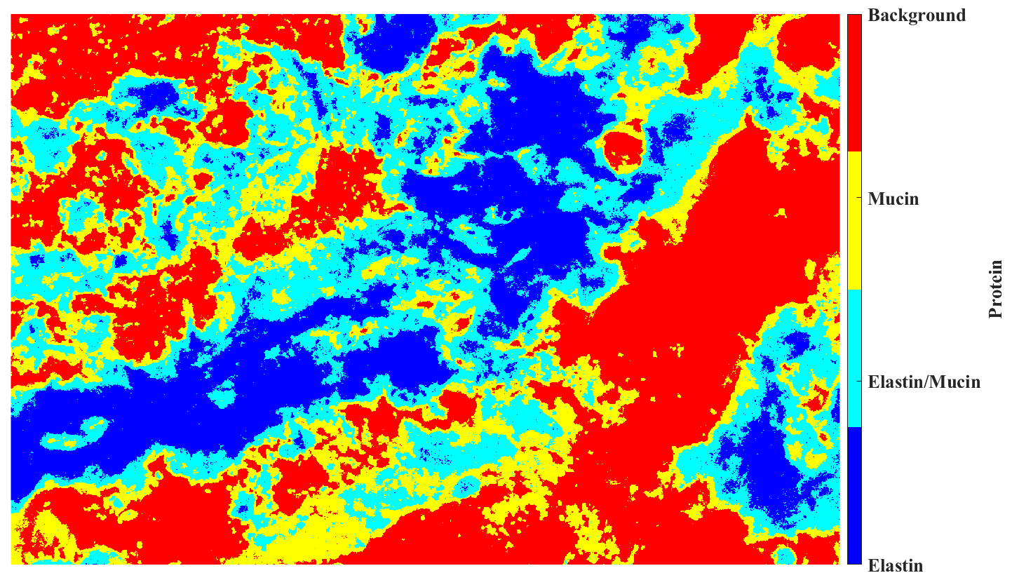
Segment Image
User asked for number of suspected proteins and their respective names. Names must be space separated.
Note: Background is a segment, but it is assumed to always be the lightest and at the end of the list and does not need to be included in the number or labels.

Slide 6
Segment Image
User asked for number of suspected proteins and their respective names. Names must be space separated.
Note: Background is a segment, but it is assumed to always be the lightest and at the end of the list and does not need to be included in the number or labels.

Slide 7
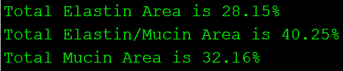
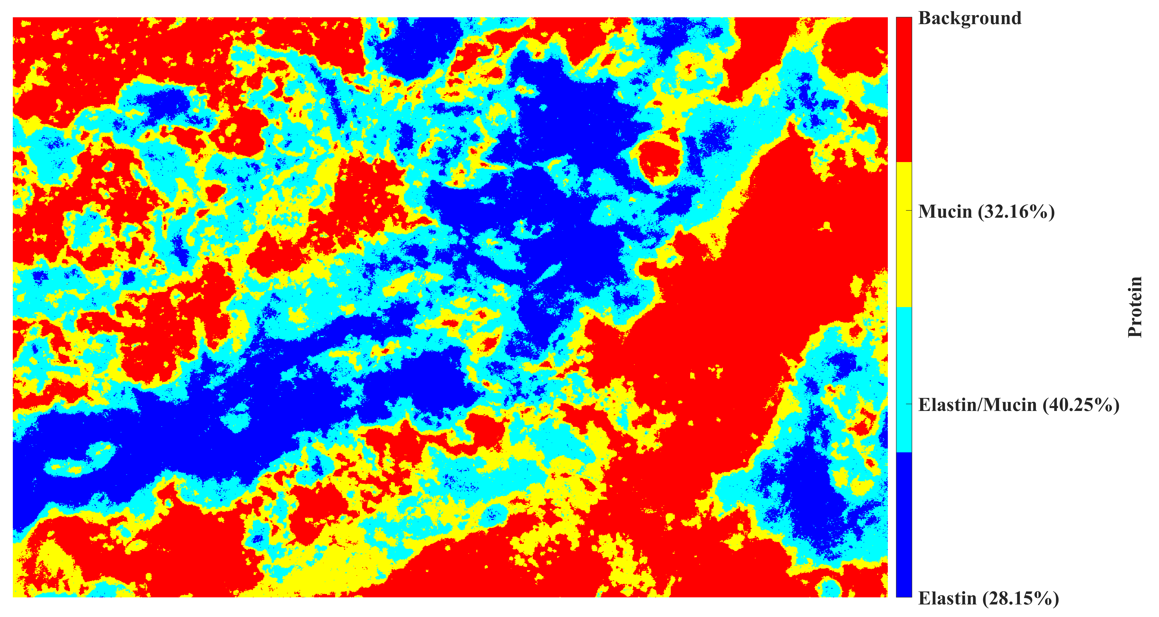
Protein Areas Calculated and Plotted
All proteins segmented regions found have their area’s calculated with respect to the total tissue.

Slide 8
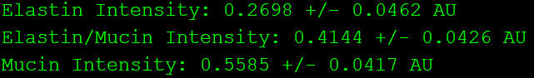
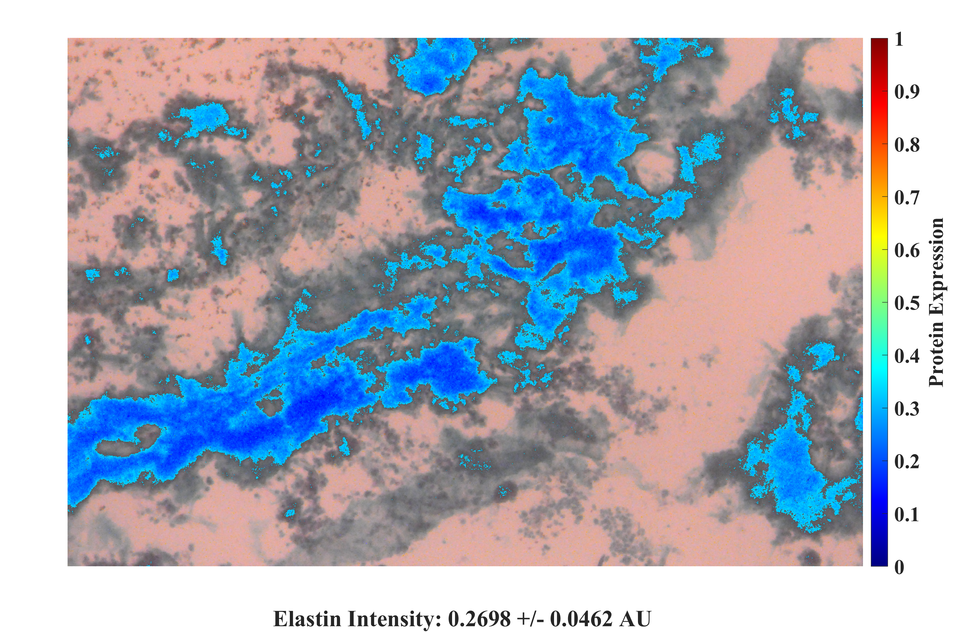
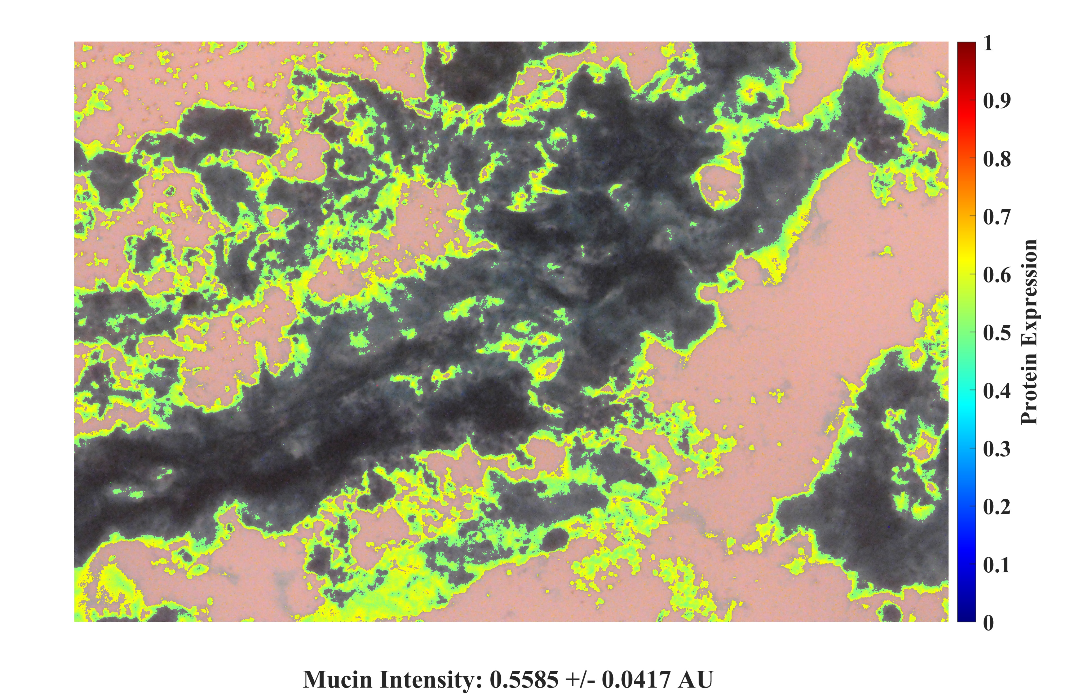
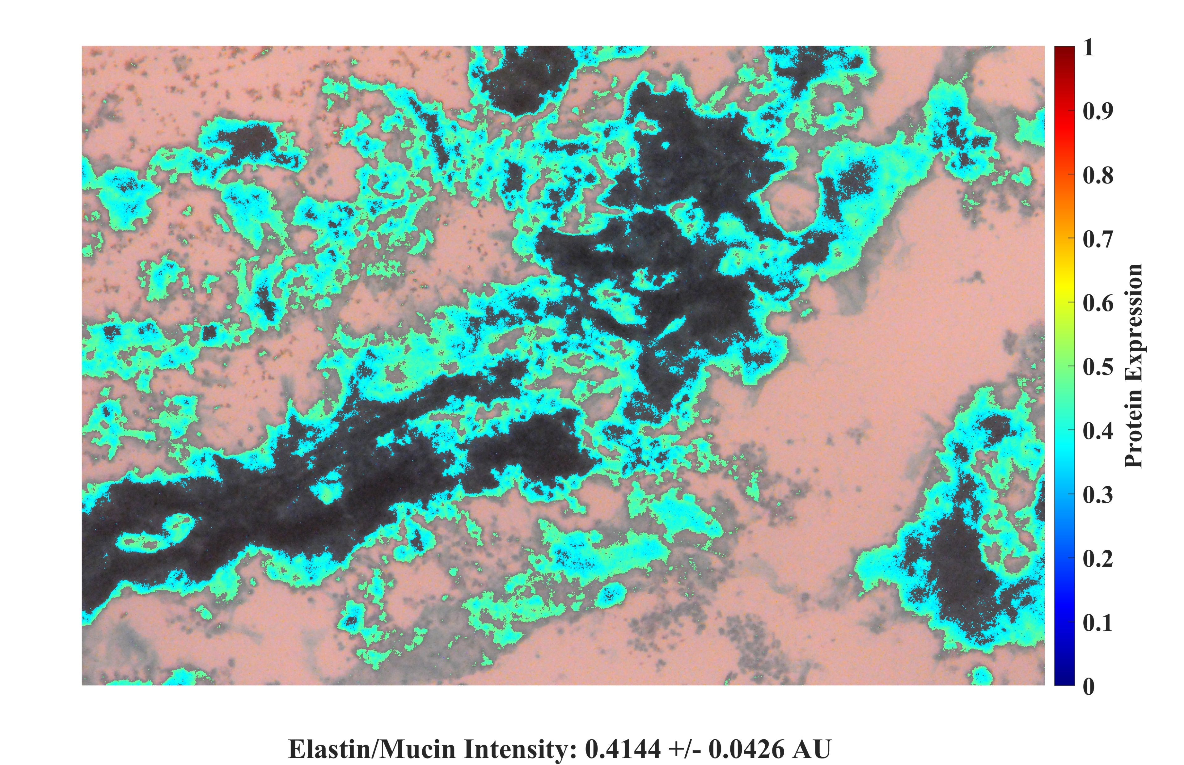
Protein Intensities Calculated and Plotted
All proteins have their respective average intensities found with standard deviations and then plotted using a colormap.

Slide 9
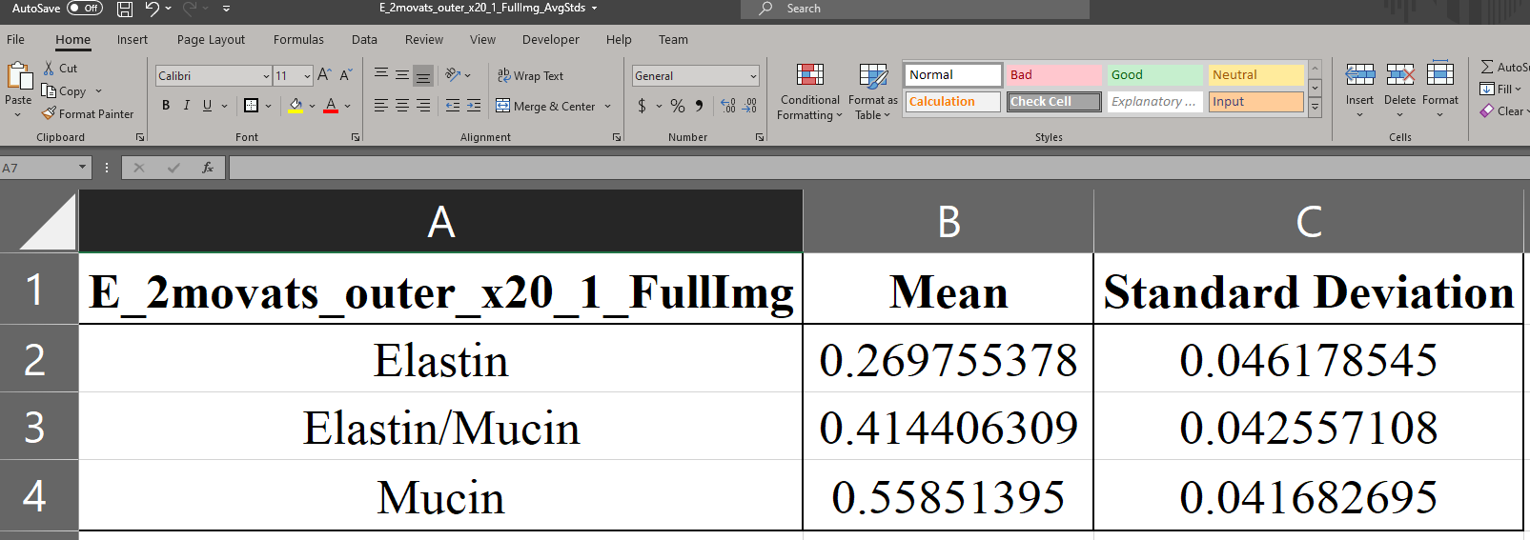
CSV File of Statistics Exported
A CSV file with automatic name generation is exported that shows labels with averages and standard deviations.

